Slide 1

GAS LEAKAGE DETECTION SYSTEM
L.SREENIVAS REDDY (20N31A6933)
III Year B.Tech – CSE(IOT)
Under the Guidance of
Mrs CH.PAVITHRA
Assistant Professor (Emerging Technologies)
B.Tech III Year – I Sem | Application Development – 1 | External Project Review

Slide 2
Abstract
The main aim of this project is to avoid the accident and death in the gas leakage explosion in house, hotels and industries.
If this gas is leaked in our kitchens, hotels or factories and not sensed in time, it may lead to fatal disaster, and may cause human and material loss.
This project comprises a gas sensing sensor for detecting the leakage of gas by using MQ2 Sensor and Arduino.
The system will setup SMS based alert mechanism using GSM Module.
The device will send messages to 2 specified mobile numbers.
And also it produces sound alert on gas leak.

Slide 3
Introduction
LPG Gas leaks have been increased drastically in the recent years of all the kitchen accidents.
The gas leakage is one of the big problems with industrial sector, residential area and gas functioning vehicles like CNG(Compressed Natural Gas) buses , cars etc.
One of the contraceptive methods to stop accidents associated with the gas leakage is to install a gas leakage detection device at vulnerable places.
This system provides the information gas leakage and immediately turns ON the buzzer for the danger indication.
Buzzer is a clear indication of gas leakage. By the detection of the hazardous gas the alerting message reached the person who has control over it from the GSM.

Slide 4
Existing System
The existing GAS LEAKAGE DETECTOR , senses the gas leakage and send’s the Emails/SMS’s to specified persons.
It does not contain power backup

Slide 5
Proposed System
The proposed system takes an automatic control action after the detection of minor LPG leakage.
It automatically shutdown the power supply and sends the SMS’s to 2 specified mobile numbers.
It is easy to operate.

Slide 6
Architecture Diagram or
System Diagram

Slide 7
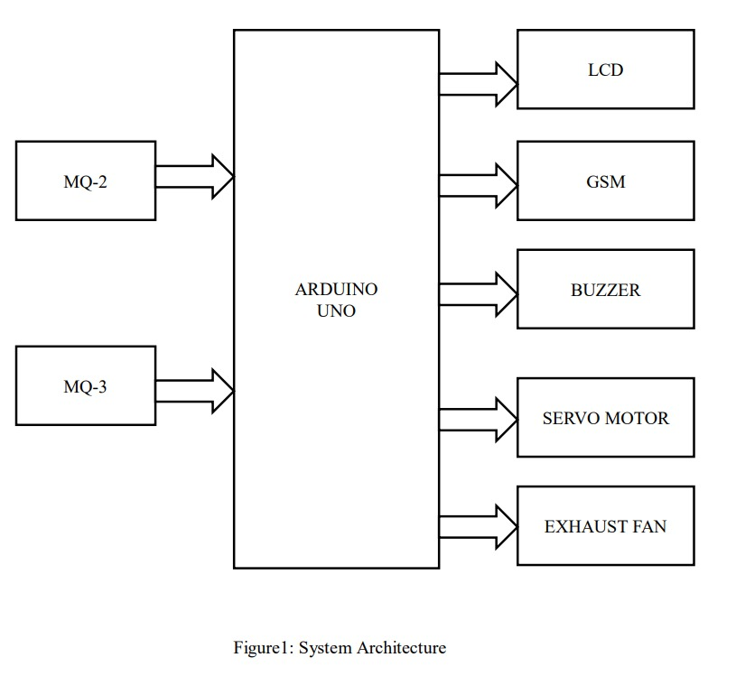
System Architecture

Slide 8
Software Requirements Specification (SRS)

Slide 9
Software Requirement Specifications (SRS)
Arduino IDE
C Programming language

Slide 10
Hardware Requirement Specifications (HRS)
CPU : Intel Core i3
RAM: 4 GB
OS: Windows 7/ Windows 8.1/ Windows 10/ Windows 11
FREE DISK SPACE: 10 GB
COMPONENTS REQUIRED:-
Arduino uno
GSM Module
MQ2, MQ3 Sensors
LCD display
Buzzer
LED’s
SERVO MOTORS, Exhaust fan

Slide 11
Application Modules
Project is divided into two modules.
Module -1 : Device
Module -2: Back-End Module

Slide 12
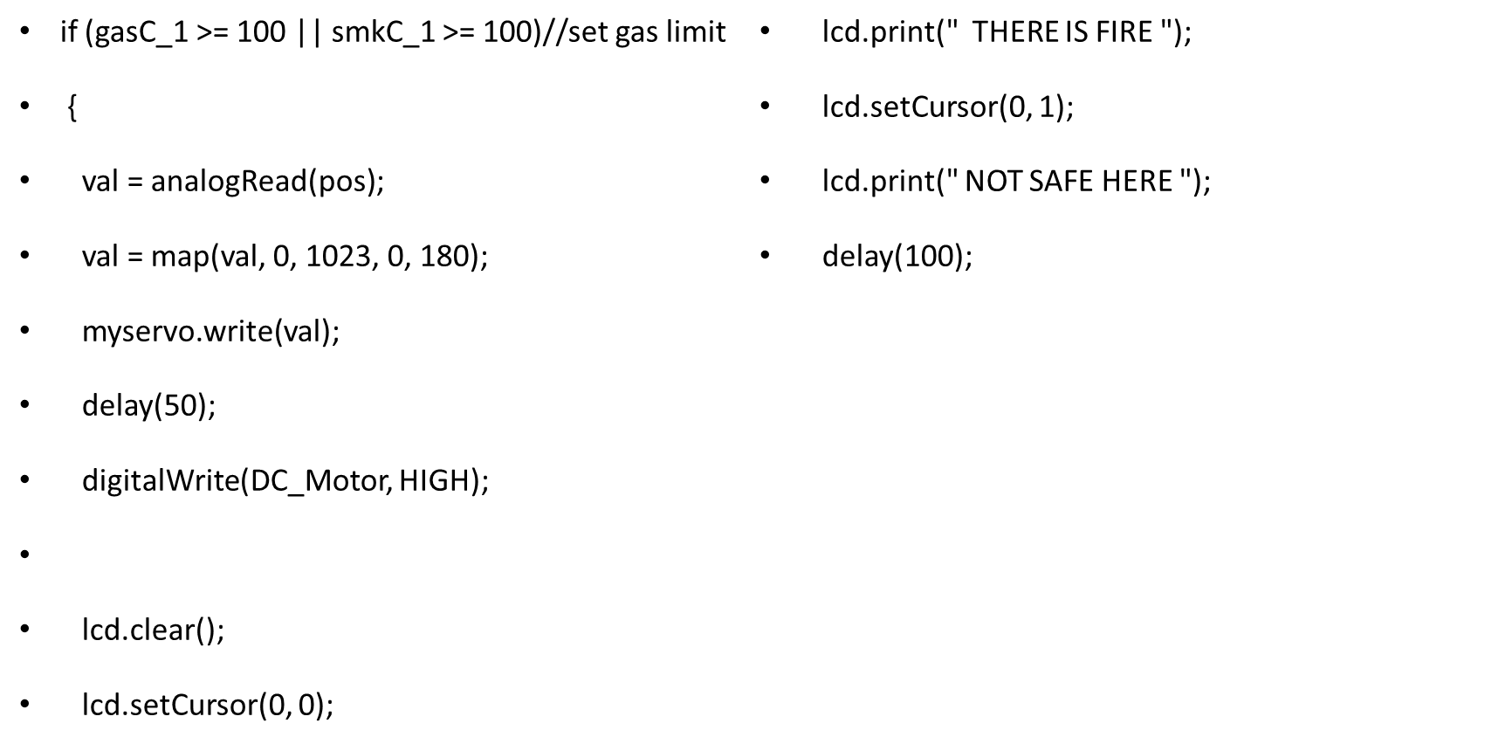
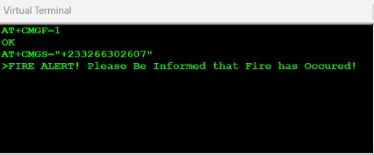

Implementation

Slide 13
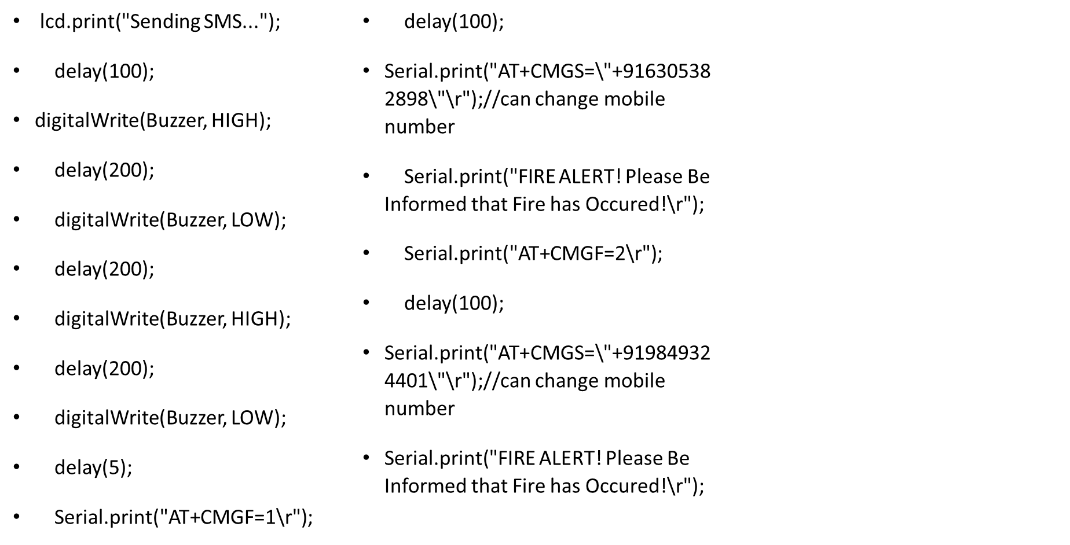

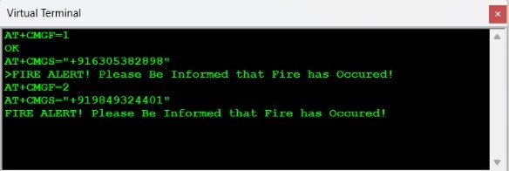

Slide 14
System Models
(UML Diagrams)

Slide 15
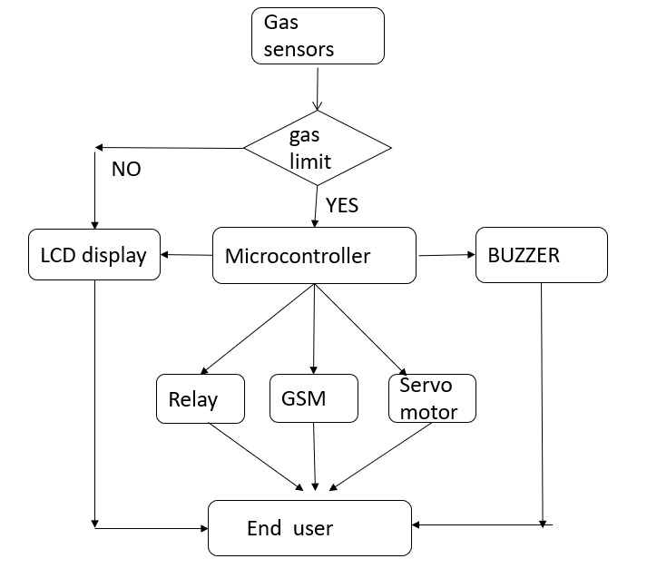
Dataflow Diagram

Slide 16
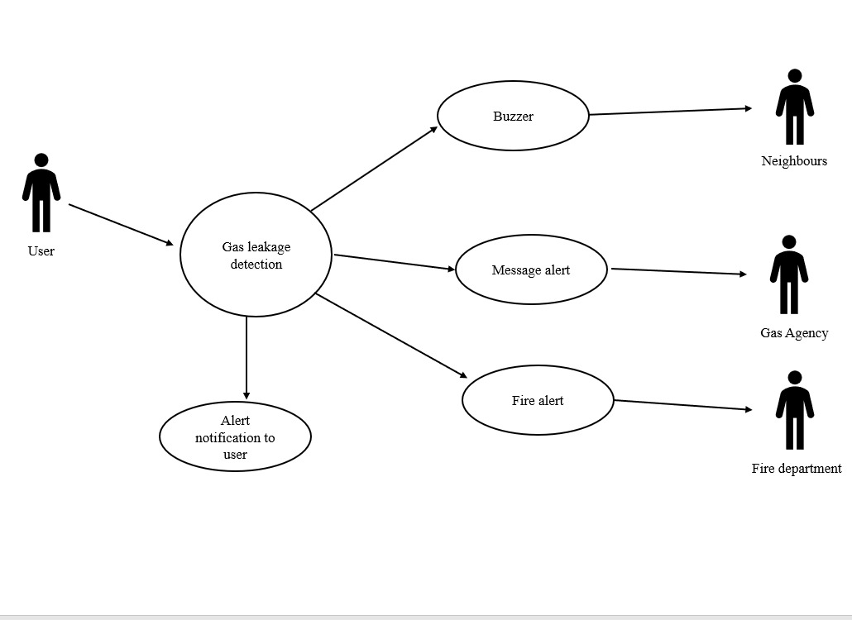
Use-Case Diagram

Slide 17
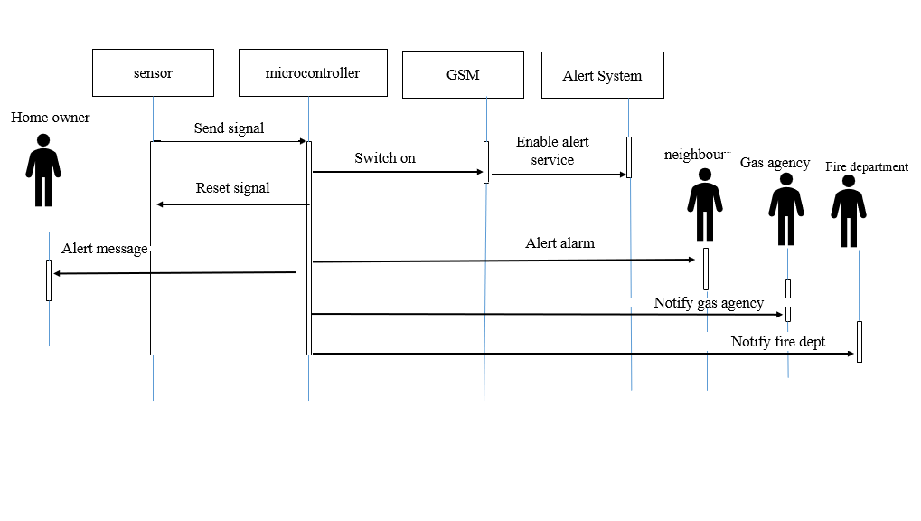
Sequential Diagram

Slide 18
Output Screens

Slide 19
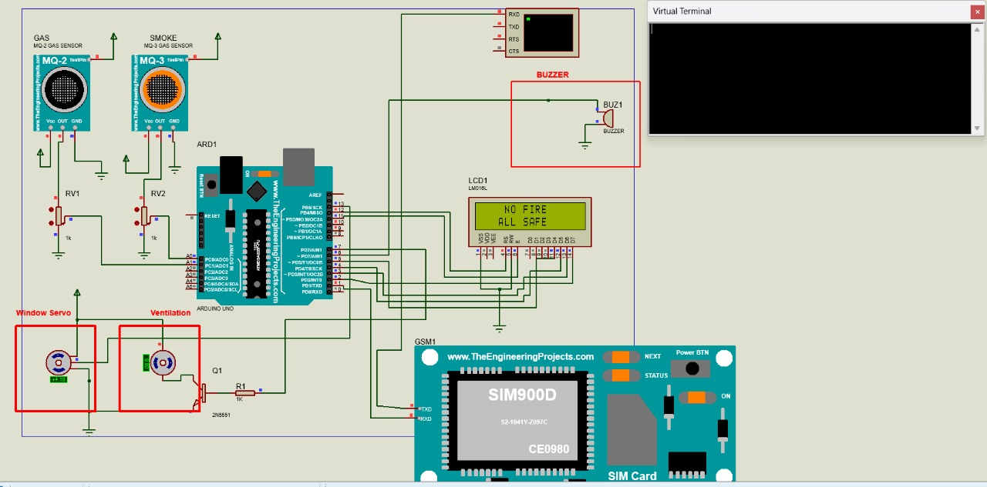
Results (Output Screens)

Slide 20
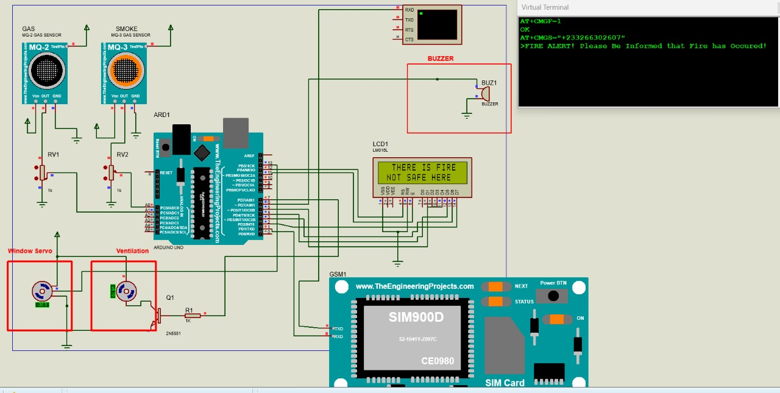

Slide 21
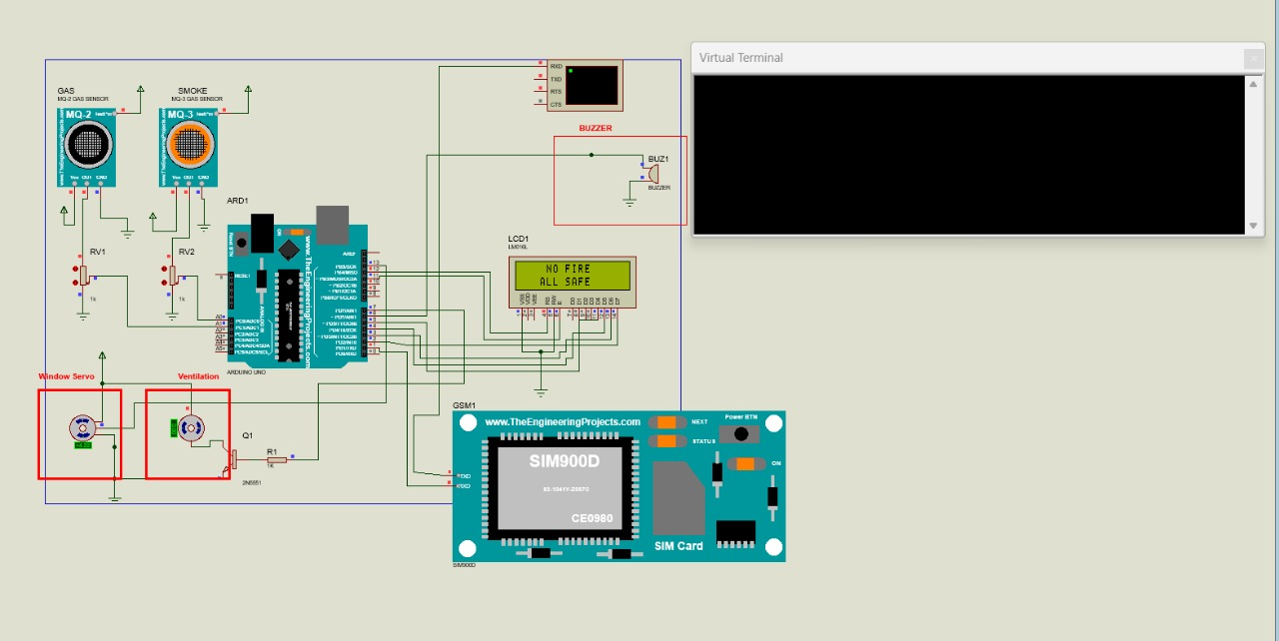

Slide 22
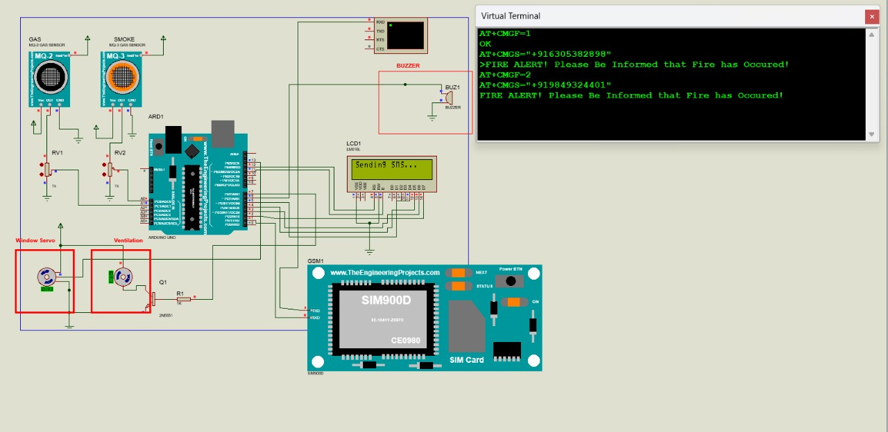

Slide 23
Conclusion &
Future Scope

Slide 24
Conclusion
Hence, the leakage of the gas causes destructible impact to the lives and as well as to the heritage of the people. So , the system consists of alarm unit which is also called as buzzer gives an audible sign of the presence of LPG volume.
The sensor are widely used to detect essence of propane , iso-butane, LPG and even smoke.
If the LPG sensor senses gas leak from workplace or home, sensor output goes to active low(logic 0) condition.
The Arduino uno turns on the LCD and buzzer. It even turns on the GSM modem after that, it continues to send messages SMS to mobile number specifically mentioned in the program.

Slide 25
Future Scope
The future scope of the project is adding more software based intelligent functions with this system.
This is an automatic gas detection , control and alert system. In future this system will have a feature where it can notify the emergency services if any accidents happen.
A mobile app and web based app for real time monitoring also will be added. The overall features will make the system safer for the users.
After designing the final prototype with smart multifuntional features, the system will be implemented in real life scenario.

Slide 26
References
[1]. Attia, Hussain A, and Halah Y. Ali. “Electronic Design of Liquefied Petroleum Gas Leakage Monitoring, Alarm, and Protection System Based on Discrete Components. ”
[2]. A Shiyana, Mrs. R Deepa, ”This embedded system is used to detect hazardous gas and to alert buzzer” 2020.
[3]. V Suma, RR Shekar KA Aksay, “This IOT system is used to detect gas leakage and also gives alarm sound to the area where the leak is accuring” 2020

Slide 27
Thank you
L.SREENIVAS REDDY

